Slide 1
Midterm Exam Review
Notes:
Please if anyone has additional comments please speak up

Slide 2
Exam Format
We will have 5 questions in the exam
One question: true/false which covers general topics.
4 other questions
  Either require calculation
  Filling pipelining tables

Slide 3
General Introduction
Technology trends, Cost trends, and Performance evaluation
Notes:
Please if anyone has additional comments please speak up

Slide 4
Computer Architecture
Definition: Computer Architecture involves 3 inter-related components
  Instruction set architecture (ISA)
  Organization
  Hardware
Technology
Programming
Languages
Applications
Computer Architecture:
• Instruction Set Design
• Organization
• Hardware
Operating
Measurement &
Evaluation
Systems
History

Slide 5
Three Computing Markets
Desktop
  Optimize price and performance (focus of this class)
Servers
  Focus on availability, scalability, and throughput
Embedded computers
  In appliances, automobiles, network devices …
    Wide performance range
    Real-time performance constraints
    Limited memory
    Low power
    Low cost
Notes:
Current computing applications are found in three distinct markets characterized by different requirements and technologies.
The largest market (in dollars) is the desktop market with low-end systems from under $1,000 to high-end workstations that cost over $10,000. The primary objective in this market is to optimize price and performance. In this market, performance is measured as computation performance and/or graphics performance. The newest high-performance microprocessors typically appear in this market. Benchmarks can provide reasonable measures of performance for this market.
For the server market, availability is critical. Many clients can suffer when a server becomes unavailable. Also, server applications often grow so that this market typically must be supported by scalable solutions. Server performance is typically evaluated based upon throughput or the number of transactions that can be supported per unit time.
The embedded computing market is the fastest growing of the three markets. While there are different definitions for embedded computing, the typical view of embedded computing holds that the computing is not necessarily an obvious component of the application. For example, laser printers contain computers, but they are purchased to serve as printers rather than as computers. Modern automobiles contain many computers, but the typically automobile owner has little idea how many of these computers are included in his or her automobile. Networking devices contain computers, but these computers only provide the functionality.

Slide 6
Trends in Technology
Trends in computer technology generally followed closely Moore’s Law “Transistor density of chips doubles every 1.5-2.0 years”.
  Processor Performance
  Memory/density density
  Logic circuits density and speed
Memory access time and disk access time do not follow Moore’s Law, and create a big gap in processor/memory performance.

Slide 7
MOORE’s LAW
Processor-DRAM Memory Gap (latency)
1000
µProc
60%/yr.
(2X/1.5yr)
CPU
“Moore’s Law”
100
Processor-Memory
Performance Gap:
(grows 50% / year)
Performance
10
DRAM
9%/yr.
(2X/10 yrs)
DRAM
1
1980
1981
1982
1983
1984
1985
1986
1987
1988
1989
1990
1991
1992
1993
1994
1995
1996
1997
1998
1999
2000
Notes:
Y-axis is performance
X-axis is time
Latency
Cliché:
Not e that x86 didn’t have cache on chip until 1989

Slide 8
Trends in Cost
High volume products lowers manufacturing costs (doubling the volume decreases cost by around 10%)
The learning curve lowers the manufacturing costs – when a product is first introduced it costs a lot, then the cost declines rapidly.
Integrated circuit (IC) costs
  Die cost
  IC cost
  Dies per wafer
Relationship between cost and price of whole computers

Slide 9
Metrics for Performance
The hardware performance is one major factor for the success of a computer system.
response time (execution time) - the time between the start and completion of an event.
throughput - the total amount of work done in a period of time.
CPU time is a very good measure of performance (important to understand) (e.g., how to compare 2 processors using CPU time, CPI – How to quantify an improvement using CPU time).
CPU Time = I x CPI x C
CPU time = Seconds = Instructions x Cycles x Seconds
Program Program Instruction Cycle

Slide 10
Factors Affecting CPU Performance
CPU time = Seconds = Instructions x Cycles x Seconds
Program Program Instruction Cycle
Instruction
Count I
CPI
Clock Cycle C
Program
X
X
Compiler
X
X
Instruction Set
Architecture (ISA)
X
X
Organization
X
X
Technology
X

Slide 11
Using Benchmarks to Evaluate and Compare the Performance of Different Processors
The most popular and industry-standard set of CPU benchmarks.
SPEC CPU2006:
  CINT2000 (11 integer programs). CFP2000 (14 floating-point intensive programs)
  Performance relative to a Sun Ultra5_10 (300 MHz) which is given a score of SPECint2000 = SPECfp2000 = 100
How to summarize performance
  Arithmetic mean
  Weighted arithmetic mean
  Geometric mean (this is what the industry uses)

Slide 12
Other measures of performance
MIPS
MFLOPS
Amdhal’s law: Suppose that enhancement E accelerates
a fraction F of the execution time (NOT Frequency) by a factor S and the remainder of the time is unaffected then (Important to understand):
Execution Time with E = ((1-F) + F/S) X Execution Time without E
1
Speedup (E) = ----------------------
(1 - F) +F/S

Slide 13
Instruction Set Architectures
Notes:
Please if anyone has additional comments please speak up

Slide 14
Instruction Set Architecture (ISA)
software
instruction set
hardware

Slide 15

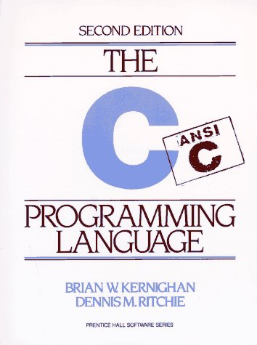
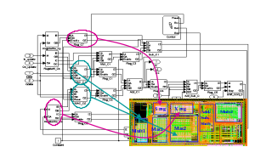
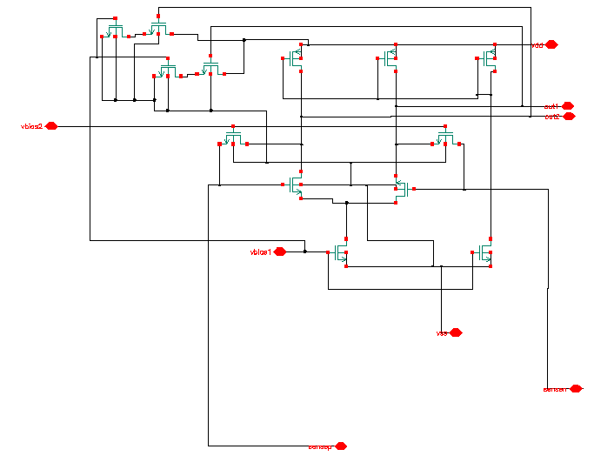
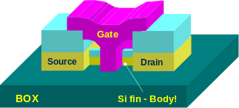
The Big Picture
SPEC
Requirements
Problem Focus
f1
f2
Algorithms
i
p
f5
f3
s
q
j
f2() {
f3(s2, &j, &i);
*s2->p = 10;
i = *s2->q + i;
}
fp
f3
Prog. Lang./OS
f4
ISA
i1: ld r1, b <p1>
i2: ld r2, c <p1>
i3: ld r5, z <p3>
i4: mul r6, r5, 3 <p3>
i5: add r3, r1, r2 <p1>
uArch
Performance Focus
Circuit
Device
Notes:
The big picture. Talk about the levels of abstraction. Talk about the fact that this is where all programs get ushered into hardware execution.
Circuits are increasing providing both opportunities (resources, bandwidth) and challenges (noise, power).
Circuits are locally designed; software is globally intertwined
Software is increasingly over designed for portability and productivity.
The path between the two domains is increasingly stressed and inadequate due to this mismatch.
The focus of the thrust is to provide a very strong path from the productivity oriented software domain into the performance oriented hardware domain.
Translate device/circuit level innovations into visible benefit at the application/software level!

Slide 16
Classifying ISA
Memory-memory architecture
  Simple compilers
  Reduced number of instructions for programs
  Slower in performance (processor-memory bottleneck)
Memory-register architecture
  In between the two.
Register-register architecture (load-store)
  Complicated compilers
  Higher memory requirements for programs
  Better performance (e.g., more efficient pipelining)

Slide 17
Memory addressing & Instruction operations
Addressing modes
  Many addressing modes exit
  Only few are frequently used (Register direct, Displacement, Immediate, Register Indirect addressing)
  We should adopt only the frequently used ones
Many opcodes (operations) have been proposed and used
Only few (around 10) are frequently used through measurements

Slide 18
RISC vs. CISC
Now there is not much difference between CISC and RISC in terms of instructions
The key difference is that RISC has fixed-length instructions and CISC has variable length instructions
In fact, internally the Pentium/AMD have RISC cores.

Slide 19
32-bit vs. 64-bit processors
The only difference is that 64-bit processors have registers of size 64 bits, and have a memory address of 64 bits wide. So accessing memory may be faster.
Their instruction length is independent from whether they are 64-bit or 32-bit processors
They can access 64 bits from memory in one clock cycle

Slide 20
Pipelining
Notes:
Please if anyone has additional comments please speak up

Slide 21
Computer Pipelining
Pipelining is an implementation technique where multiple operations on a number of instructions are overlapped in execution.
An instruction execution pipeline involves a number of steps, where each step completes a part of an instruction.
Each step is called a pipe stage or a pipe segment.
Throughput of an instruction pipeline is determined by how often an instruction exists the pipeline.
The time to move an instruction one step down the line is equal to the machine cycle and is determined by the stage with the longest processing delay.

Slide 22
Pipelining: Design Goals
An important pipeline design consideration is to balance the length of each pipeline stage.
Pipelining doesn’t help latency of single instruction, but it helps throughput of entire program
Pipeline rate is limited by the slowest pipeline stage
Under these ideal conditions:
  Speedup from pipelining equals the number of pipeline stages
  One instruction is completed every cycle, CPI = 1.

Slide 23
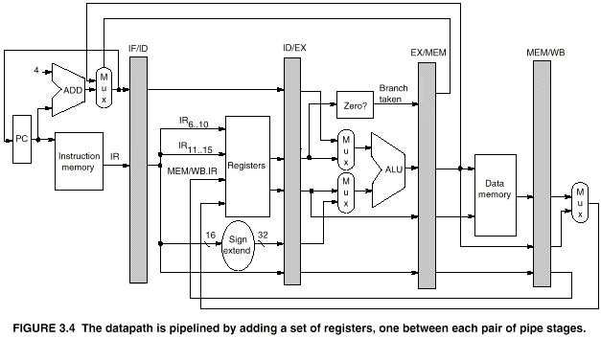
A 5-stage Pipelined MIPS Datapath

Slide 24
Pipelined Example -
Executing Multiple Instructions
Consider the following instruction sequence:
    lw $r0, 10($r1)
    sw $sr3, 20($r4)
    add $r5, $r6, $r7
    sub $r8, $r9, $r10

Slide 25
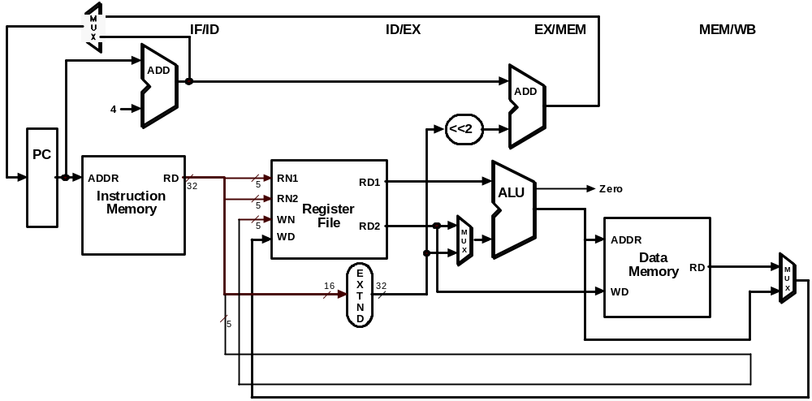
Executing Multiple Instructions
Clock Cycle 1
LW

Slide 26
Executing Multiple Instructions
Clock Cycle 2
SW
LW

Slide 27
Executing Multiple Instructions
Clock Cycle 3
ADD
SW
LW

Slide 28
Executing Multiple Instructions
Clock Cycle 4
SUB
ADD
SW
LW

Slide 29
Executing Multiple Instructions
Clock Cycle 5
SUB
ADD
SW
LW

Slide 30
Executing Multiple Instructions
Clock Cycle 6
SUB
ADD
SW

Slide 31
Executing Multiple Instructions
Clock Cycle 7
SUB
ADD

Slide 32
Executing Multiple Instructions
Clock Cycle 8
SUB

Slide 33
Processor Pipelining
There are two ways that pipelining can help:
  Reduce the clock cycle time, and keep the same CPI
  Reduce the CPI, and keep the same clock cycle time
  CPU time = Instruction count * CPI * Clock cycle time

Slide 34
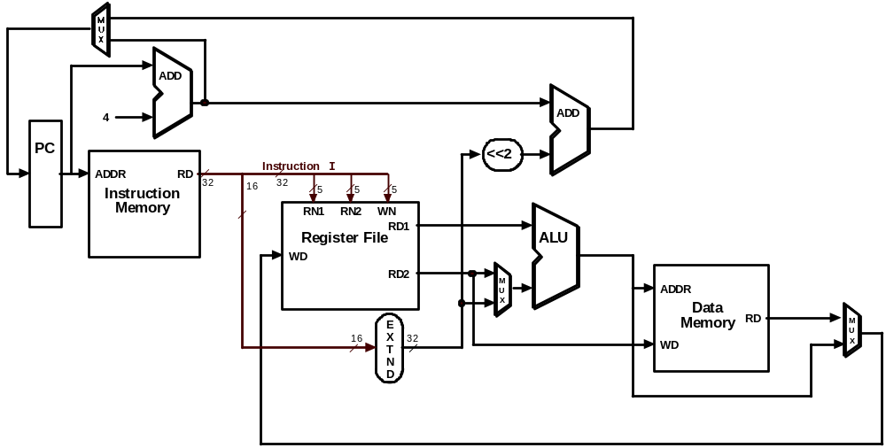
Reduce the clock cycle time, and keep the same CPI
CPI = 1
Clock = X Hz

Slide 35

Reduce the clock cycle time, and keep the same CPI
CPI = 1
Clock = X*5 Hz
Pipeline Registers
ADD
4
ADD
PC
<<2
ADDR
RD
Instruction
I
Instruction
32
16
32
5
5
5
Memory
RN1
RN2
WN
Register File
RD1
ALU
WD
RD2
M
ADDR
U
X
Data
E
Memory
RD
M
16
X
32
U
T
WD
X
N
D

Slide 36
Reduce the CPI, and keep the same cycle time
CPI = 5
Clock = X*5 Hz

Slide 37
Reduce the CPI, and keep the same cycle time
Pipeline Registers
CPI = 1
Clock = X*5 Hz
ADD
4
ADD
PC
<<2
ADDR
RD
Instruction
I
Instruction
32
16
32
5
5
5
Memory
RN1
RN2
WN
Register File
RD1
ALU
WD
RD2
M
ADDR
U
X
Data
E
Memory
RD
M
16
X
32
U
T
WD
X
N
D

Slide 38
Pipelining: Performance
We looked at the performance (speedup, latency, CPI) of pipelined under many settings
  Unbalanced stages
  Different number of stages
  Additional pipelining overhead
IF
ID
EX
MEM
WB
5 ns
4 ns
5 ns
10 ns
4 ns
IF
ID
EX
MEM1
MEM2
WB
5 ns
4 ns
5 ns
5 ns
5 ns
4 ns

Slide 39
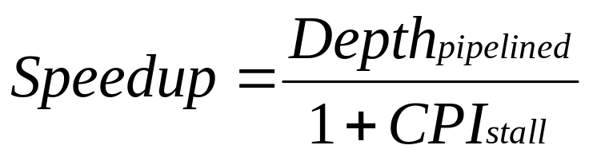
Pipelining is Not That Easy for Computers
Limits to pipelining: Hazards prevent next instruction from executing during its designated clock cycle
  Structural hazards
  Data hazards
  Control hazards
A possible solution is to “stall” the pipeline until the hazard is resolved, inserting one or more “bubbles” in the pipeline
We looked at the performance of pipelines with hazards

Slide 40
Techniques to Reduce Stalls
  Structural hazards
    Memory: Separate instruction and data memory
    Registers: Write 1st half of cycle and read 2nd half of cycle
Mem
Mem
Reg
Reg
ALU

Slide 41
Data Hazard Classification
Different Types of Hazards (We need to know)
  RAW (read after write)
  WAW (write after write)
  WAR (write after read)
  RAR (read after read): Not a hazard.
RAW will always happen (true dependence) in any pipeline
WAW and WAR can happen in certain pipelines
Sometimes it can be avoided using register renaming

Slide 42
Techniques to Reduce data hazards
Hardware Schemes to Reduce:
  Data Hazards
    Forwarding
Zero?
MUX MUX
D/A Buffer
A/M Buffer
M/W Buffer
ALU
Data
Memory

Slide 43
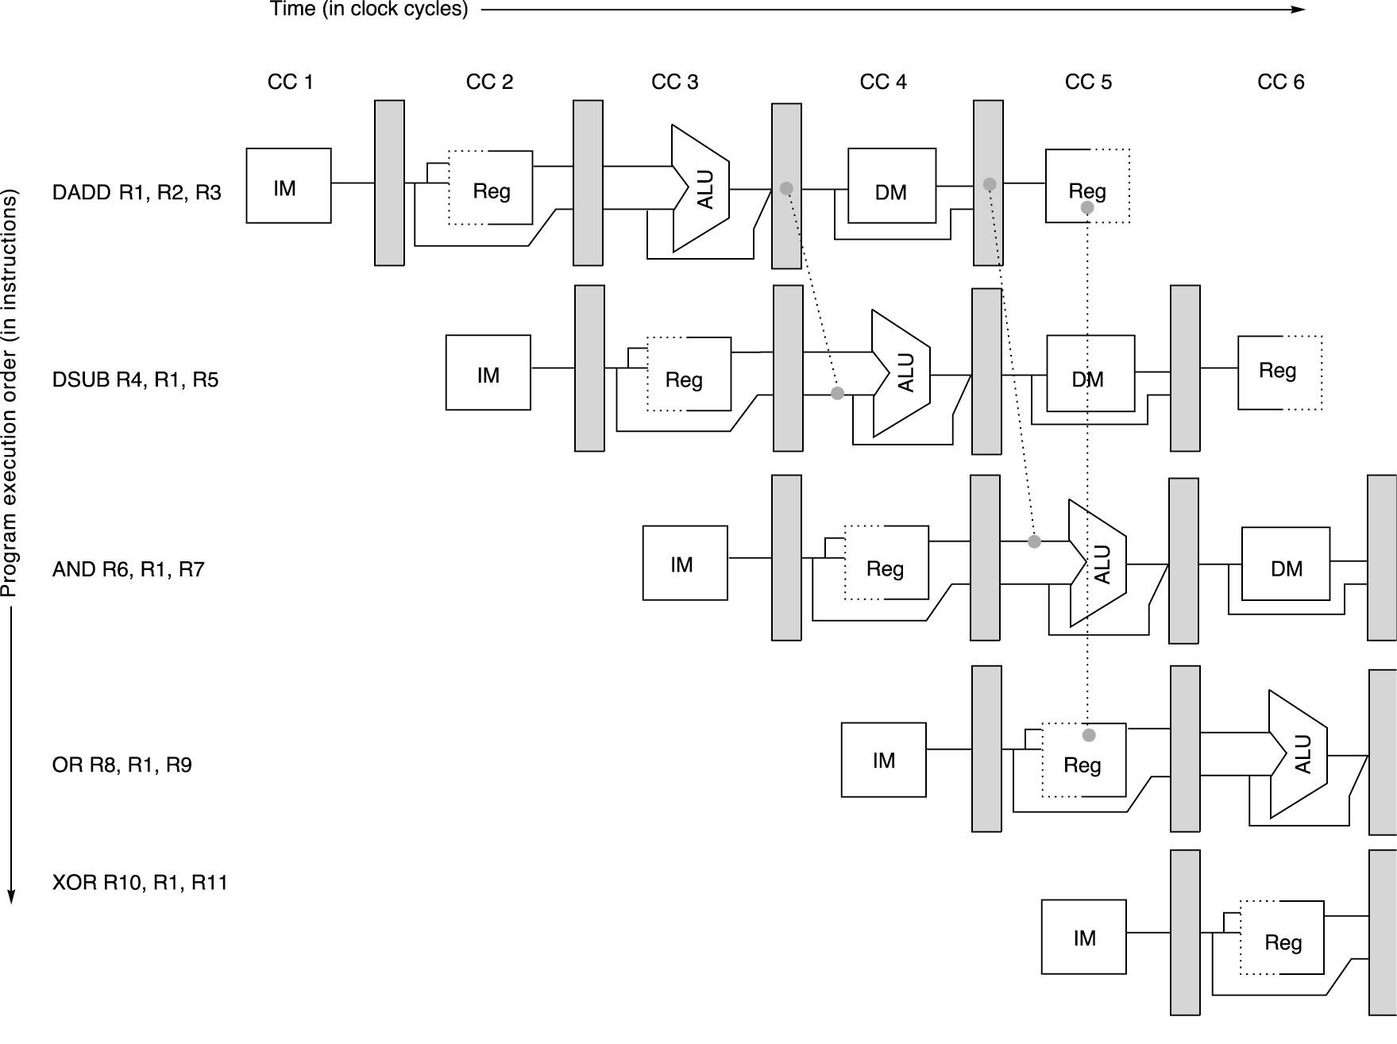
Pipeline with Forwarding:
Could avoid stalls
A set of instructions that depend on the DADD result uses forwarding paths to avoid the data hazard

Slide 44
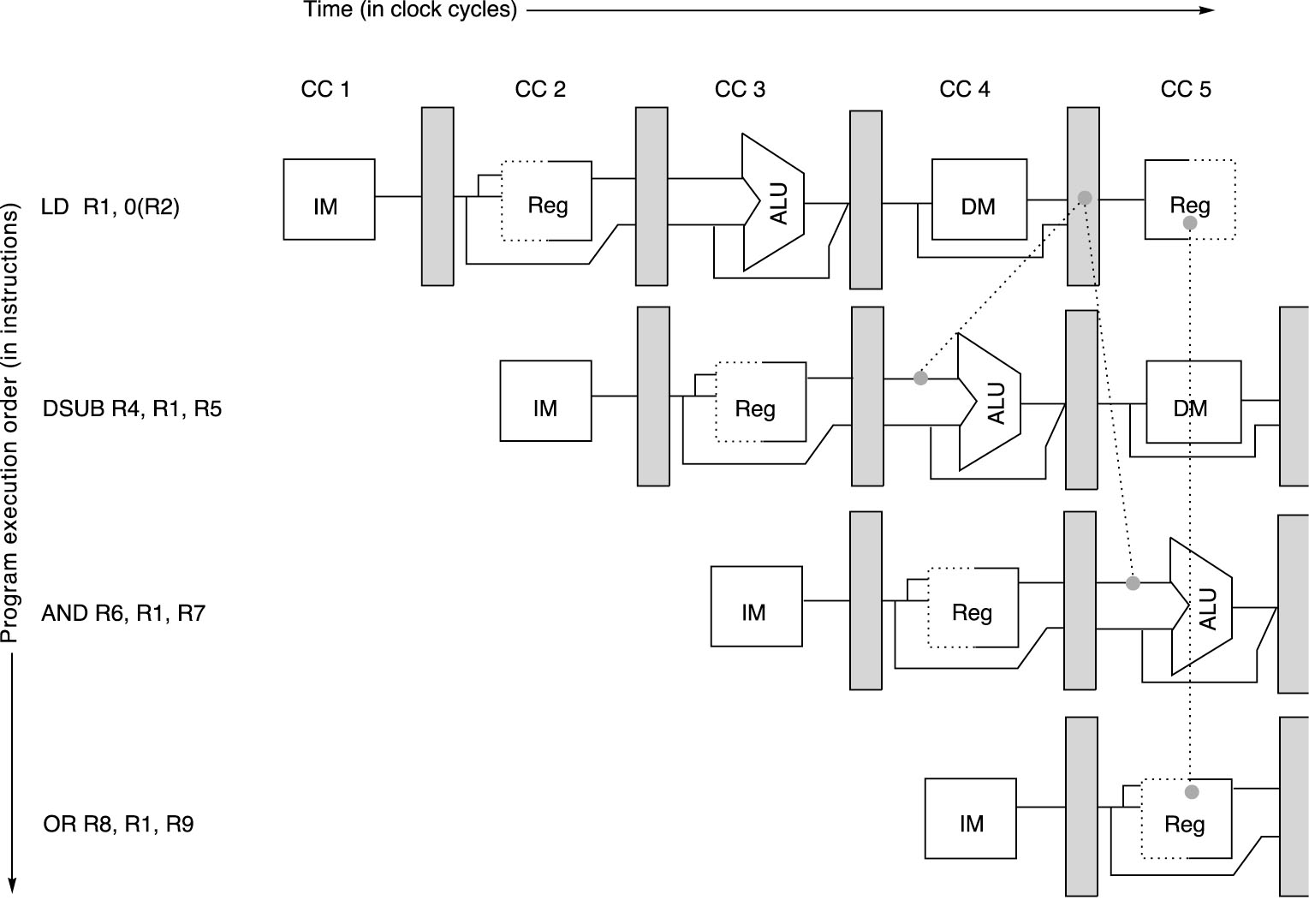

Slide 45
Techniques to Reduce Stalls
Software Schemes to Reduce:
  Data Hazards
    Compiler Scheduling: reduce load stalls
Original code with stalls:
LD Rb,b
LD Rc,c
DADD Ra,Rb,Rc
SD Ra,a
LD Re,e
LD Rf,f
DSUB Rd,Re,Rf
SD Rd,d
Scheduled code with no stalls:
LD Rb,b
LD Rc,c
LD Re,e
DADD Ra,Rb,Rc
LD Rf,f
SD Ra,a
DSUB Rd,Re,Rf
SD Rd,d
Stall
Stall

Slide 46
Control Hazards
When a conditional branch is executed it may change the PC and, without any special measures, leads to stalling the pipeline for a number of cycles until the branch condition is known.
Branch instruction IF ID EX MEM WB
Branch successor IF stall stall IF ID EX MEM WB
Branch successor + 1 IF ID EX MEM WB
Branch successor + 2 IF ID EX MEM
Branch successor + 3 IF ID EX
Branch successor + 4 IF ID
Branch successor + 5 IF
Three clock cycles are wasted for every branch for current MIPS pipeline

Slide 47
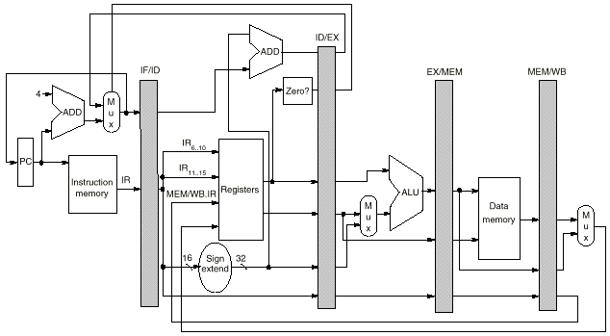
Techniques to Reduce Stalls
Hardware Schemes to Reduce:
  Control Hazards
    Moving the calculation of the target branch earlier in the pipeline

Slide 48
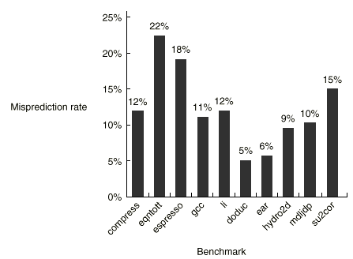
Techniques to Reduce Stalls
Software Schemes to Reduce:
  Control Hazards
    Branch prediction
      Example : choosing backward branches (loop) as taken and forward branches (if) as not taken
      Tracing Program behaviour

Slide 49
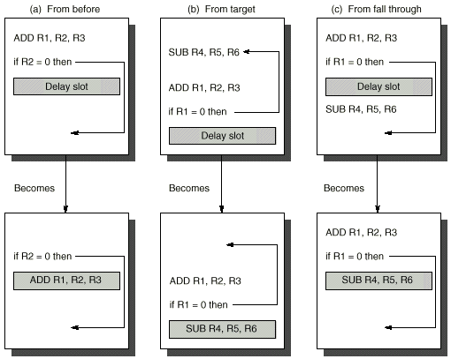
(A)
(B)
(C)

Slide 50
Dynamic Branch Prediction
Builds on the premise that history matters
  Observe the behavior of branches in previous instances and try to predict future branch behavior
  Try to predict the outcome of a branch early on in order to avoid stalls
  Branch prediction is critical for multiple issue processors
    In an n-issue processor, branches will come n times faster than a single issue processor

Slide 51
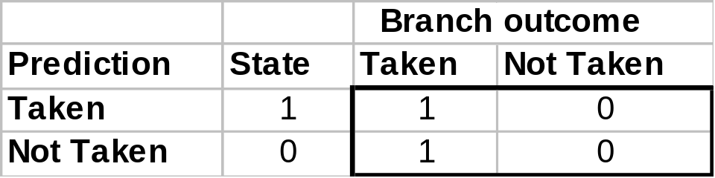
Basic Branch Predictor
Use a 1-bit branch predictor buffer or branch history table
1 bit of memory stating whether the branch was recently taken or not
Bit entry updated each time the branch instruction is executed
T
NT
NT
State 1
Predict
Taken
State 0
Predict
Not Taken
T

Slide 52
1-bit Branch Prediction Buffer
Problem – even simplest branches are mispredicted twice
LD R1, #5
Loop: LD R2, 0(R5)
ADD R2, R2, R4
STORE R2, 0(R5)
ADD R5, R5, #4
SUB R1, R1, #1
BNEZ R1, Loop
First time: prediction = 0
but the branch is taken ⇒ change
prediction to 1 miss
Time 2, 3, 4: prediction = 1
and the branch is taken
Time 5: prediction = 1
but the branch is not taken ⇒ change
prediction to 0 miss

Slide 53
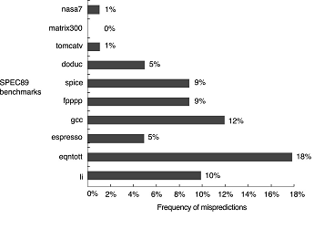
Dynamic Branch Prediction Accuracy

Slide 54
Performance of Branch Schemes
The effective pipeline speedup with branch penalties: (assuming an ideal pipeline CPI of 1)
Pipeline speedup = Pipeline depth
1 + Pipeline stall cycles from branches
Pipeline stall cycles from branches = Branch frequency X branch penalty
Pipeline speedup = Pipeline Depth
1 + Branch frequency X Branch penalty

Slide 55
Evaluating Branch Alternatives
Scheduling Branch CPI speedup v. scheme penalty unpipelined
Stall pipeline 1 1.14 4.4
Predict taken 1 1.14 4.4
Predict not taken 1 1.09 4.5
Delayed branch 0.5 1.07 4.6
Conditional & Unconditional = 14%, 65% change PC (taken)

Slide 56
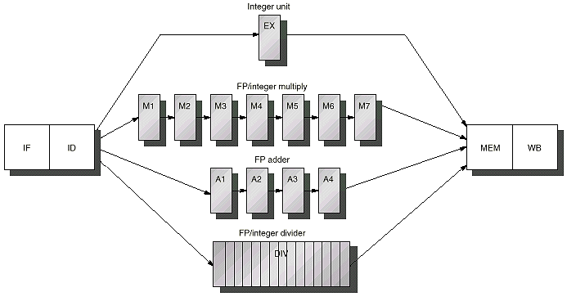
Extending The MIPS Pipeline:
Multiple Outstanding Floating Point Operations
Latency = 6
Initiation Interval = 1
Pipelined
Integer Unit
Latency = 0
Initiation Interval = 1
Hazards:
RAW, WAW possible
WAR Not Possible
Structural: Possible
Control: Possible
Floating Point (FP)/Integer Multiply
IF
ID
EX
MEM
WB
FP Adder
Latency = 3
Initiation Interval = 1
Pipelined
FP/Integer Divider
Latency = 24
Initiation Interval = 25
Non-pipelined

Slide 57
Latencies and Initiation Intervals For
Functional Units
Functional Unit Latency Initiation Interval
Integer ALU 0 1
Data Memory 1 1
(Integer and FP Loads)
FP add 3 1
FP multiply 6 1
(also integer multiply)
FP divide 24 25
(also integer divide)
Latency usually equals stall cycles when full forwarding is used

Slide 58
Must know how to fill these pipelines: taking into consideration pipeline stages and hazards
CC 1
CC 2
CC 3
CC 4
CC 5
CC 6
CC 7
CC 8
CC 9
CC 10
CC 11 CC12 CC13 CC14 CC15 CC16 CC17 CC18
L.D F4, 0(R2)
IF
ID
EX
MEM
WB
MUL.D F0, F4, F6
IF
ID
STALL
M1
M2
M3
M4
M5
M6
M7
MEM
WB
ADD.D F2, F0, F8
IF
STALL
ID
STALL
STALL
STALL
STALL
STALL
STALL
A1
A2
A3
A4
MEM
WB
S.D F2, 0(R2)
IF
STALL
STALL
STALL
STALL
STALL
STALL
ID
EX
STALL
STALL
STALL
MEM
WB

Slide 59
Techniques to Reduce Stalls
Software Schemes to Reduce:
  Data Hazards
    Compiler Scheduling: register renaming to eliminate WAW and WAR hazards

Slide 60
Increasing Instruction-Level Parallelism
A common way to increase parallelism among instructions is to exploit parallelism among iterations of a loop
  (i.e Loop Level Parallelism, LLP).
This is accomplished by unrolling the loop either statically by the compiler, or dynamically by hardware, which increases the size of the basic block present.
We get significant improvements
We looked at ways to determine when it is safe to unroll the loop?

Slide 61
Loop Unrolling Example: Key to increasing ILP
For the loop:
for (i=1; i<=1000; i++)
x(i) = x(i) + s;;
The straightforward MIPS assembly code is given by:
Instruction Instruction Latency in
producing result using result clock cycles
FP ALU op Another FP ALU op 3
FP ALU op Store double 2
Load double FP ALU op 1
Load double Store double 0
Integer op Integer op 0
Loop: L.D F0, 0 (R1)
ADD.D F4, F0, F2
S.D F4, 0(R1)
SUBI R1, R1, # 8
BNE R1,Loop

Slide 62
Loop Showing Stalls and Code Re-arrangement
1 Loop: LD F0,0(R1)
2 stall
3 ADDD F4,F0,F2
4 stall
5 stall
6 SD 0(R1),F4
7 SUBI R1,R1,8
8 BNEZ R1,Loop
9 stall
9 clock cycles per loop iteration.
1Loop: LD F0,0(R1)
2 Stall
3 ADDD F4,F0,F2
4 SUBI R1,R1,8
5 BNEZ R1,Loop
6 SD 8(R1),F4
Code now takes 6 clock cycles per loop iteration
Speedup = 9/6 = 1.5
The number of cycles cannot be reduced further because:
  The body of the loop is small
  The loop overhead (SUBI R1, R1, 8 and BNEZ R1, Loop)

Slide 63
Basic Loop Unrolling
Concept:
4n iterations
n iterations
4 iterations
4 iterations

Slide 64
Unroll Loop Four Times to expose more ILP and reduce loop overhead
1 Loop: LD F0,0(R1)
2 ADDD F4,F0,F2
3 SD 0(R1),F4 ;drop SUBI & BNEZ
4 LD F6,-8(R1)
5 ADDD F8,F6,F2
6 SD -8(R1),F8 ;drop SUBI & BNEZ
7 LD F10,-16(R1)
8 ADDD F12,F10,F2
9 SD -16(R1),F12 ;drop SUBI & BNEZ
10 LD F14,-24(R1)
11 ADDD F16,F14,F2
12 SD -24(R1),F16
13 SUBI R1,R1,#32
14 BNEZ R1,LOOP
15 stall
15 + 4 x (2 + 1)= 27 clock cycles, or 6.8 cycles per iteration (2 stalls after each ADDD and 1 stall after each LD)
1 Loop: LD F0,0(R1)
2 LD F6,-8(R1)
3 LD F10,-16(R1)
4 LD F14,-24(R1)
5 ADDD F4,F0,F2
6 ADDD F8,F6,F2
7 ADDD F12,F10,F2
8 ADDD F16,F14,F2
9 SD 0(R1),F4
10 SD -8(R1),F8
11 SD -16(R1),F8
12 SUBI R1,R1,#32
13 BNEZ R1,LOOP
14 SD 8(R1),F16
14 clock cycles or 3.5 clock cycles per iteration

Slide 65
Techniques to Increase ILP
Software Schemes to Reduce:
  Control Hazards
    Increase loop parallelism
for (i=1; i<=100; i=i+1) {
A[i] = A[i] + B[i]; /* S1 */
B[i+1] = C[i] + D[i]; /* S2 */
}
  Can be made parallel by replacing the code with the following:
  A[1] = A[1] + B[1];
  for (i=1; i<=99; i=i+1) {
  B[i+1] = C[i] + D[i];
  A[i+1] = A[i+1] + B[i+1];
  }
  B[101] = C[100] + D[100];

Slide 66
Using these Hardware and Software Techniques
Pipeline CPI = Ideal pipeline CPI + Structural Stalls + Data Hazard Stalls + Control Stalls
  All we can achieve is to be close to the ideal CPI =1
  In practice CPI is around +- 10% ideal one
This is because we can only issue one instruction per clock cycle to the pipeline
How can we do better ?

Slide 67
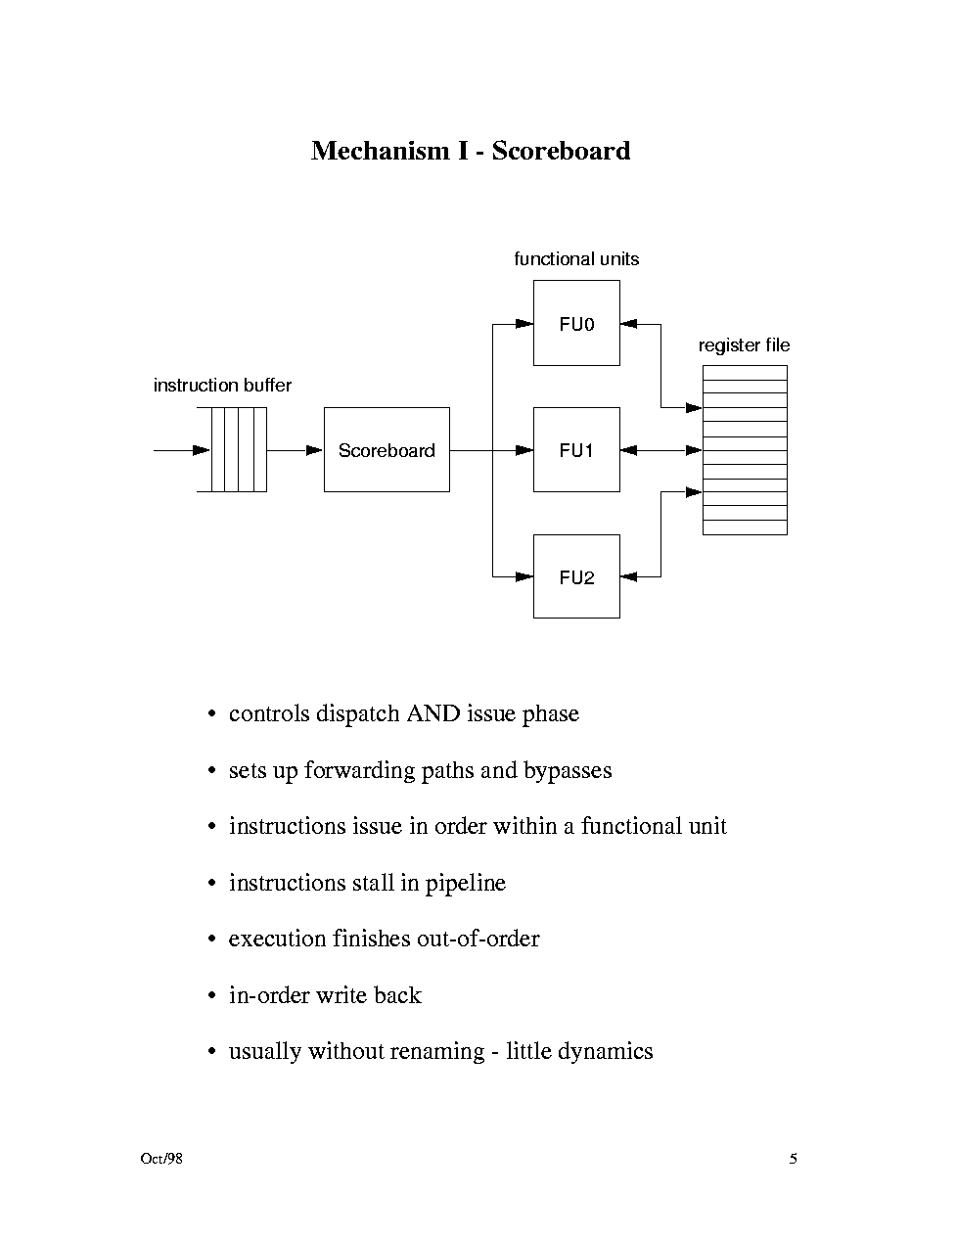
Out-of-order execution
Scorboarding
  Instruction issue in order
  Instruction execution out of order

Slide 68
Techniques to Reduce Stalls and Increase ILP
Hardware Schemes to increase ILP:
  Scoreboarding
    Allows out-of-order execution of instructions
Instruction status
Read
Execution
Write
Instruction
j
k
Issue
operands
complete
Result
L.D
F6
34+
R2
1
2
3
4
L.D
F2
45+
R3
5
6
7
8
MUL.D
F0
F2
F4
6
9
19
20
SUB.D
F8
F6
F2
7
9
11
12
DIV.D
F10
F0
F6
8
21
61
62
ADD.D
F6
F8
F2
13
14
16
22
We have:
  In-oder issue,
  Out-of-order execute and commit

